Slide 1
Vector Algebra and Swerve
ThunderChickens – FRC Team 217
Swerve drivebase example

Slide 2
What is a vector?
Has a direction and magnitude
  Velocity
  Position
  Force
Has a head and a tail
  The tail is the starting point of the vector
  The head is the pointed end of the vector arrow
Can be broken into components
Can be added and subtracted
Has three different methods of “multiplication”
  By a scalar
  By another vector:
    Dot product (gives us a scalar)
    Cross product (also called the vector product because it gives us a vector)

Slide 3
What is a scalar?
Has a magnitude but no direction
  Speed
  Volume
  Mass
Described by real numbers*
  *Some branches of mathematics also use complex (imaginary) numbers

Slide 4

Breaking down 2-D vectors
Given a 2-D vector $\overset{⃑}{v}$ with magnitude $\left\|\overset{⃑}{v}\right\|$ and direction $θ$:
  $\overset{⃑}{v}=\left\langle \left\|\overset{⃑}{v}\right\|\cos\left(θ\right),\left\|\overset{⃑}{v}\right\|\sin\left(θ\right) \right\rangle$
  $=\left\|\overset{⃑}{v}\right\|\cos\left(θ\right)\hat{i}+\left\|\overset{⃑}{v}\right\|\sin\left(θ\right)\hat{j}$
    $\left\|\overset{⃑}{v}\right\|\cos\left(θ\right)$ is the $\hat{i}$ component, $\left\|\overset{⃑}{v}\right\|\sin\left(θ\right)$ is the $\hat{j}$ component
    $\hat{i}$ is a unit vector pointing along x
    $\hat{j}$ is a unit vector pointing along y
    A unit vector has a magnitude of 1
You can also go backwards. Given $\overset{⃑}{v}=\left\langle x,y\right\rangle$:
  $\left\|\overset{⃑}{v}\right\|=\sqrt{x^{2}+y^{2}}$
  $θ=\tan^{−1}({\frac{y}{x}})$

Slide 5

Scaling Vectors
Given $\overset{⃑}{v}=\left\langle x,y\right\rangle$ and a scalar $c$:
  $c\overset{⃑}{v}=\left\langle cx,cy\right\rangle$
  $\left\|\overset{⃑}{v}\right\|$ is scaled by $c$
  $θ$ is unchanged

Slide 6

Adding and Subtracting Vectors
Given $\overset{⃑}{u}=\left\langle u_{1},u_{2}\right\rangle$ and $\overset{⃑}{v}=\left\langle v_{1},v_{2}\right\rangle$:
  $\overset{⃑}{u}+\overset{⃑}{v}=\left\langle u_{1}+v_{1},u_{2}+v_{2}\right\rangle$
    NOTE: Adding vectors does NOT add the vector magnitudes together; it adds the component magnitudes together
  $\overset{⃑}{u}−\overset{⃑}{v}=\left\langle u_{1}−v_{1},u_{2}−v_{2}\right\rangle$
Geometrically:
  Adding vectors attaches the tail of the second vector to the head of the first
  Subtracting vectors:
    Flips the second vector’s head and tail (scales it by -1)
    Attaches the tail of the flipped second vector to the head of the first

Slide 7
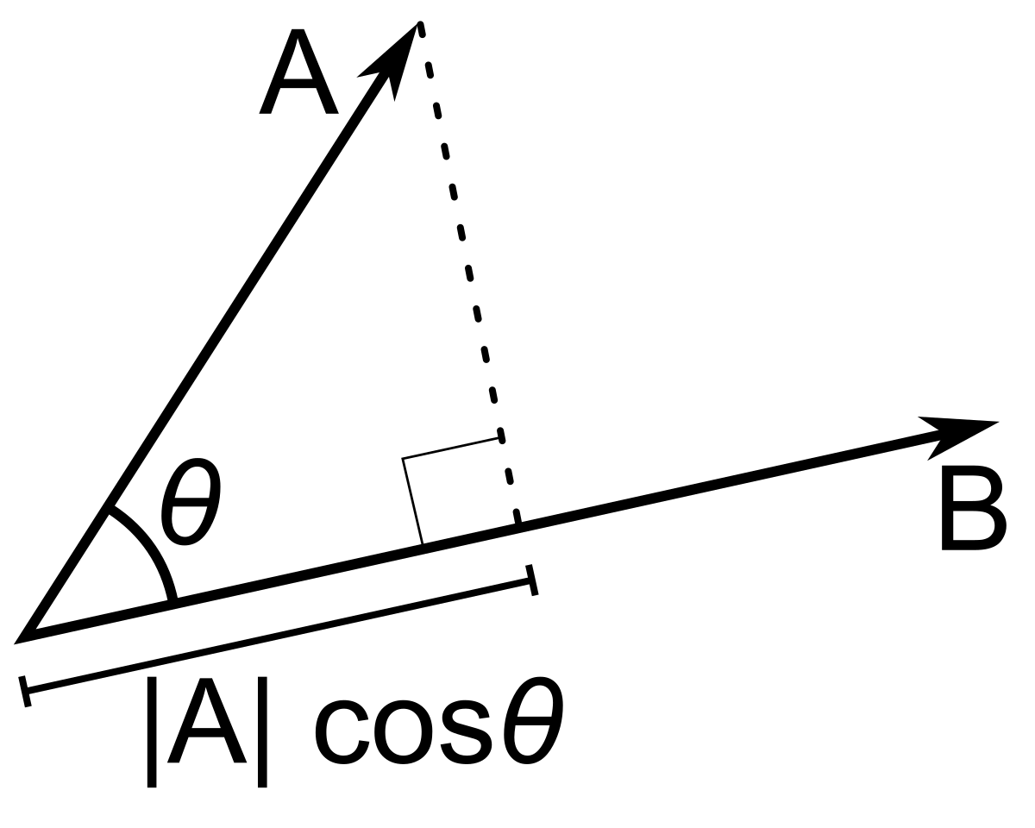

Dot Product
Given $\overset{⃑}{u}=\left\langle u_{1},u_{2}\right\rangle$ and $\overset{⃑}{v}=\left\langle v_{1},v_{2}\right\rangle$:
  $\overset{⃑}{u}∙\overset{⃑}{v}=u_{1}v_{1}+u_{2}v_{2}$
What does this mean?
Given $\left\|\overset{⃑}{u}\right\|$, $\left\|\overset{⃑}{v}\right\|$, and the angle $θ$ between $\overset{⃑}{u}$ and $\overset{⃑}{v}$:
  $\overset{⃑}{u}∙\overset{⃑}{v}=\left\|\overset{⃑}{u}\right\|\left\|\overset{⃑}{v}\right\|cos⁡(θ)$
Dot product $\overset{⃑}{u}∙\overset{⃑}{v}$ gives us the magnitude of $\overset{⃑}{u}$ in the direction of $\overset{⃑}{v}$, and vice versa

Slide 8
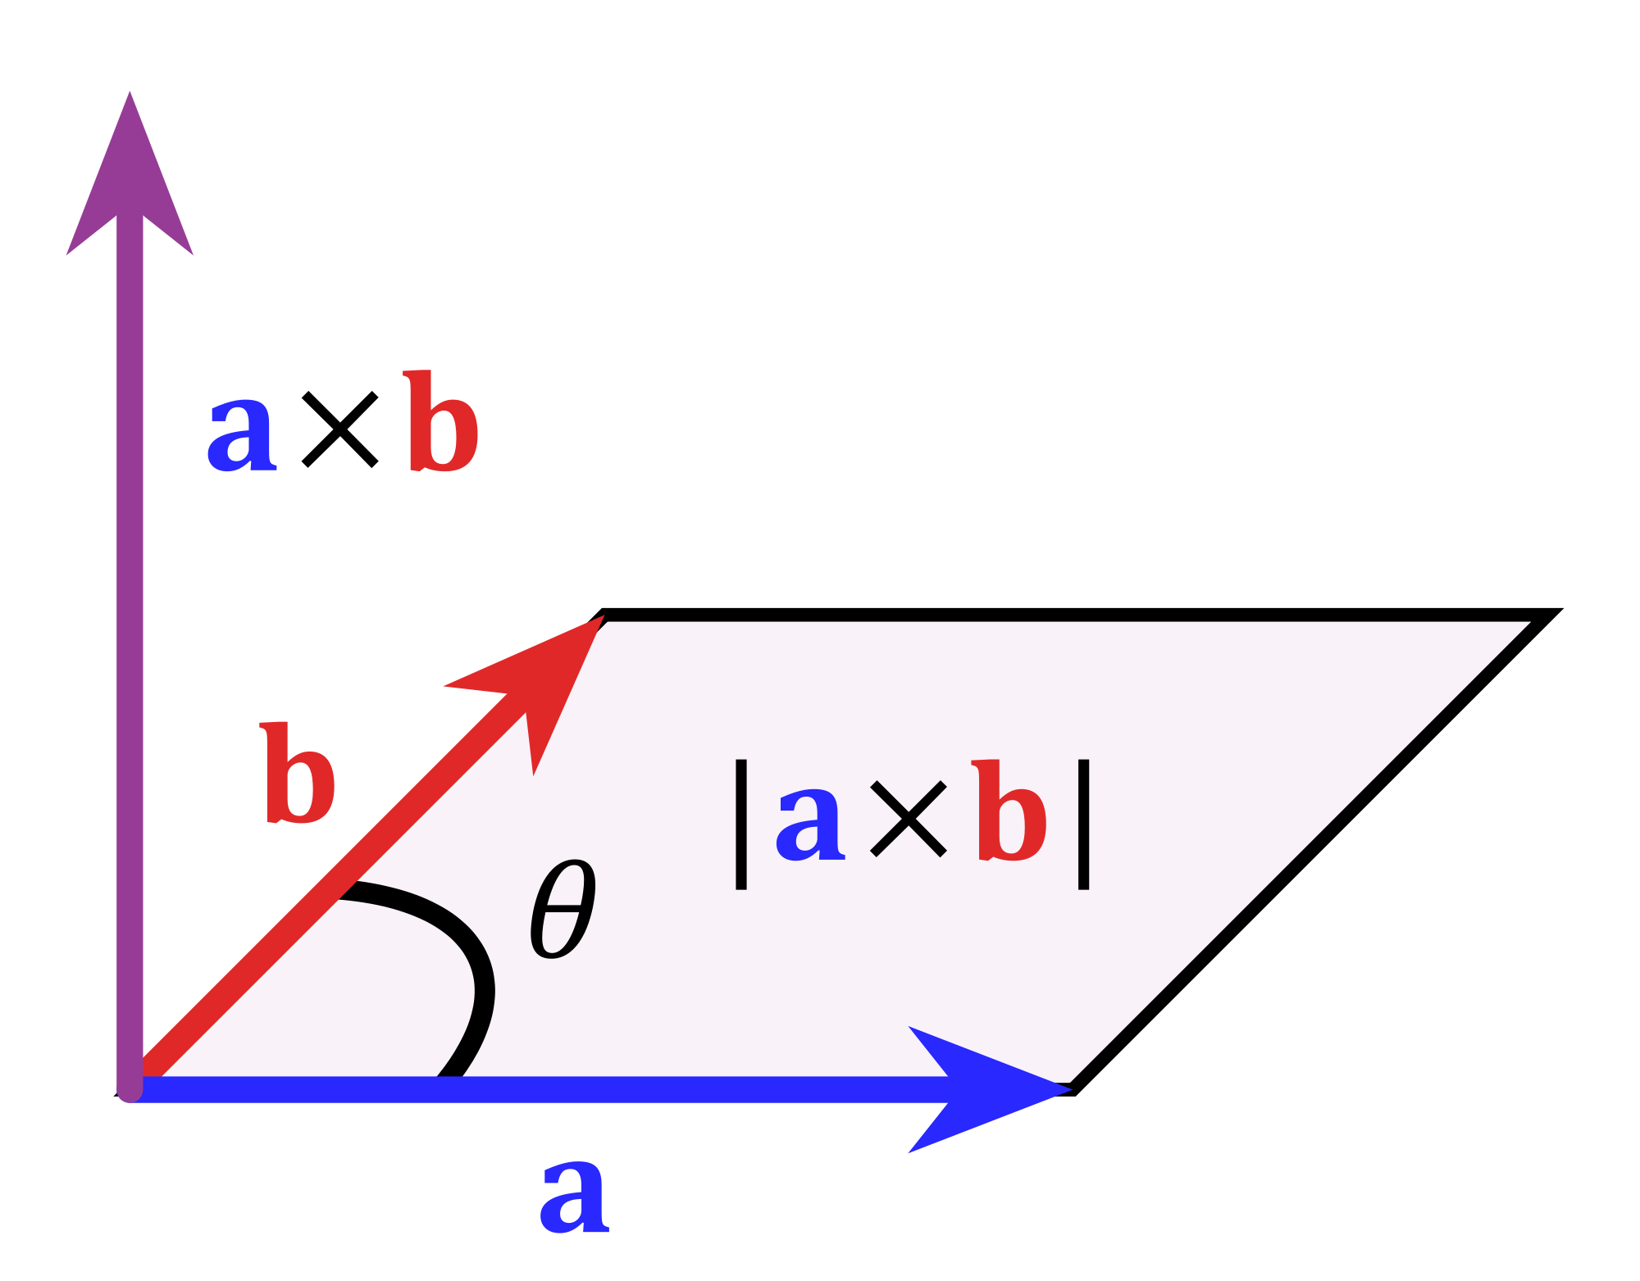

Cross Product
Given $\overset{⃑}{u}=\left\langle u_{1},u_{2},u_{3}\right\rangle$ and $\overset{⃑}{v}=\left\langle v_{1},v_{2},v_{3}\right\rangle$:
  $\overset{⃑}{u}×\overset{⃑}{v}=\det\left(\left[\begin{matrix}\hat{i} & u_{1} & v_{1} \\ \hat{j} & u_{2} & v_{2} \\ \hat{k} & u_{3} & v_{3}\end{matrix}\right]\right)$
  $=\hat{i}(u_{2}v_{3}−$ $u_{3}v_{2})−\hat{j}\left(u_{1}v_{3}− u_{3}v_{1}\right)+\hat{k}\left(u_{1}v_{2}− u_{2}v_{1}\right)$
  $=\left[\begin{matrix}u_{2}v_{3}− u_{3}v_{2} \\ u_{3}v_{1}− u_{1}v_{3} \\ u_{1}v_{2}− u_{2}v_{1}\end{matrix}\right]$
What does this mean?
Given $\left\|\overset{⃑}{u}\right\|$, $\left\|\overset{⃑}{v}\right\|$, and the angle $θ$ between $\overset{⃑}{u}$ and $\overset{⃑}{v}$:
  $\left\|\overset{⃑}{u}×\overset{⃑}{v}\right\|=\left\|\overset{⃑}{u}\right\|\left\|\overset{⃑}{v}\right\|\left|sin⁡(θ)\right|=Area of a parallelogram$
Cross product $\overset{⃑}{u}×\overset{⃑}{v}$ gives us a vector perpendicular to both $\overset{⃑}{u}$ and $\overset{⃑}{v}$ with magnitude equivalent to the area of the parallelogram formed by $\overset{⃑}{u}$ and $\overset{⃑}{v}$

Slide 9

Cross Product – Proof
Given $\overset{⃑}{u}=\left\langle u_{1},u_{2},u_{3}\right\rangle$ and $\overset{⃑}{v}=\left\langle v_{1},v_{2},v_{3}\right\rangle$:
  $\overset{⃑}{u}×\overset{⃑}{v}=\left[\begin{matrix}u_{2}v_{3}− u_{3}v_{2} \\ u_{3}v_{1}− u_{1}v_{3} \\ u_{1}v_{2}− u_{2}v_{1}\end{matrix}\right]$
  $\left[\begin{matrix}u_{2}v_{3}− u_{3}v_{2} \\ u_{3}v_{1}− u_{1}v_{3} \\ u_{1}v_{2}− u_{2}v_{1}\end{matrix}\right]$ $∙$ $\left[\begin{matrix} u_{1} \\ u_{2} \\ u_{3}\end{matrix}\right]=u_{1}\left(u_{2}v_{3}− u_{3}v_{2}\right)+u_{2}\left(u_{3}v_{1}− u_{1}v_{3}\right)+u_{3}\left(u_{1}v_{2}− u_{2}v_{1}\right)$
  $=u_{1}u_{2}v_{3}−u_{1}u_{3}v_{2}+u_{2}u_{3}v_{1}−u_{1}u_{2}v_{3}+u_{1}u_{3}v_{2}−u_{2}u_{3}v_{1}=0$
  $\left[\begin{matrix}u_{2}v_{3}− u_{3}v_{2} \\ u_{3}v_{1}− u_{1}v_{3} \\ u_{1}v_{2}− u_{2}v_{1}\end{matrix}\right]$ $∙$ $\left[\begin{matrix} v_{1} \\ v_{2} \\ v_{3}\end{matrix}\right]=v_{1}\left(u_{2}v_{3}− u_{3}v_{2}\right)+v_{2}\left(u_{3}v_{1}− u_{1}v_{3}\right)+v_{3}\left(u_{1}v_{2}− u_{2}v_{1}\right)$
  $=u_{2}v_{1}v_{3}−u_{3}v_{1}v_{2}+u_{3}v_{1}v_{2}−u_{1}v_{2}v_{3}+u_{1}v_{2}v_{3}−u_{2}v_{1}v_{3}=0$

Slide 10

properties of VectoRS
Commutative property: $\overset{⃑}{u}+\overset{⃑}{v}=\overset{⃑}{v}+\overset{⃑}{u}$
Associative property: $\overset{⃑}{u}+\left(\overset{⃑}{v}+\overset{⃑}{w}\right)=\left(\overset{⃑}{u}+\overset{⃑}{v}\right)+\overset{⃑}{w}$
Identity property: $1\overset{⃑}{v}=\overset{⃑}{v}$
Zero property: $0\overset{⃑}{v}=\overset{⃑}{0}$
  $\overset{⃑}{0}=\left\langle 0,0\right\rangle$
Distributive property:
  $c\left(\overset{⃑}{u}+\overset{⃑}{v}\right)=c\overset{⃑}{u}+c\overset{⃑}{v}$
$(c+d)\overset{⃑}{v}=c\overset{⃑}{v}+d\overset{⃑}{v}$
Two non-zero vectors $\overset{⃑}{u}$ and $\overset{⃑}{v}$ are parallel if $\overset{⃑}{u}=c\overset{⃑}{v}$ for some scalar $c$
Cancellation property: If $\overset{⃑}{u}+\overset{⃑}{v}=\overset{⃑}{u}+\overset{⃑}{w}$, then $\overset{⃑}{v}=\overset{⃑}{w}$

Slide 11

properties of the Dot Product
Commutative property: $\overset{⃑}{u}∙\overset{⃑}{v}=\overset{⃑}{v}∙\overset{⃑}{u}$
Not associative
  The dot product returns a scalar, so $\overset{⃑}{u}∙\overset{⃑}{v}∙\overset{⃑}{w}$ is invalid
Scalar multiplication property: $c\left(\overset{⃑}{u}∙\overset{⃑}{v}\right)=c\overset{⃑}{u}∙\overset{⃑}{v}=\overset{⃑}{u}∙c\overset{⃑}{v}$
Zero property: $\overset{⃑}{v}∙\overset{⃑}{0}=0$
Distributive property: $\overset{⃑}{u}∙\left(\overset{⃑}{v}+\overset{⃑}{w}\right)=\overset{⃑}{u}∙\overset{⃑}{v}+\overset{⃑}{u}∙\overset{⃑}{w}$
Bilinear property: $\overset{⃑}{u}∙\left(c\overset{⃑}{v}+\overset{⃑}{w}\right)=c(\overset{⃑}{u}∙\overset{⃑}{v})+\overset{⃑}{u}∙\overset{⃑}{w}$
Two non-zero vectors $\overset{⃑}{u}$ and $\overset{⃑}{v}$ are orthogonal if $\overset{⃑}{u}∙\overset{⃑}{v}=0$
No cancellation
  $\left\langle 6,3\right\rangle ∙\left\langle 3,2\right\rangle =24=\left\langle 6,3\right\rangle ∙\left\langle 4,0\right\rangle$, but $\left\langle 3,2\right\rangle ≠\left\langle 4,0\right\rangle$
  Using the distributive property, $\overset{⃑}{u}∙\left(\overset{⃑}{v}−\overset{⃑}{w}\right)=0$, so $\left\langle 3,2\right\rangle −\left\langle 4,0\right\rangle =\left\langle −1,2\right\rangle$ is orthogonal to $\left\langle 6,3\right\rangle$

Slide 12

properties of the Cross Product
Anti-commutative property: $\overset{⃑}{u}×\overset{⃑}{v}=−(\overset{⃑}{v}×\overset{⃑}{u})$
Not associative
  Satisfies the Jacobi Identity: $\overset{⃑}{u}×\left(\overset{⃑}{v}×\overset{⃑}{w}\right)−\overset{⃑}{v}×\left(\overset{⃑}{u}×\overset{⃑}{w}\right)+\overset{⃑}{w}×(\overset{⃑}{u}×\overset{⃑}{v})=0$
Scalar multiplication property: $c\left(\overset{⃑}{u}×\overset{⃑}{v}\right)=c\overset{⃑}{u}×\overset{⃑}{v}=\overset{⃑}{u}×c\overset{⃑}{v}$
Zero property: $\overset{⃑}{v}×\overset{⃑}{0}=\overset{⃑}{0}$
Distributive property: $\overset{⃑}{u}×\left(\overset{⃑}{v}+\overset{⃑}{w}\right)=\overset{⃑}{u}×\overset{⃑}{v}+\overset{⃑}{u}×\overset{⃑}{w}$
Bilinear property: $\overset{⃑}{u}×\left(c\overset{⃑}{v}+\overset{⃑}{w}\right)=c(\overset{⃑}{u}×\overset{⃑}{v})+\overset{⃑}{u}×\overset{⃑}{w}$
Two non-zero vectors $\overset{⃑}{u}$ and $\overset{⃑}{v}$ are parallel if $\overset{⃑}{u}×\overset{⃑}{v}=0$
No cancellation
  $\overset{⃑}{u}×\overset{⃑}{v}=\overset{⃑}{u}×\overset{⃑}{w}$ does not imply $\overset{⃑}{v}=\overset{⃑}{w}$
  Using the distributive property, $\overset{⃑}{u}×\left(\overset{⃑}{v}−\overset{⃑}{w}\right)=0$

Slide 13

Vectors in Swerve:
Overview
The four wheels in swerve can each be represented by vectors
  Magnitude is speed
  Direction is wheel angle
  Swerve wheels operate in 2-D space, so we can break down the vectors into $\left\langle x,y\right\rangle$
A matrix is a collection of vectors, so we can represent the wheel vectors in a 4x2 matrix (4 rows, 2 columns => 4 wheels, $\left\langle x,y\right\rangle$)
  In code, a matrix is a 2-D array wheels[rows][columns]
  We will start at the front left wheel and go around clockwise when numbering our rows

Slide 14
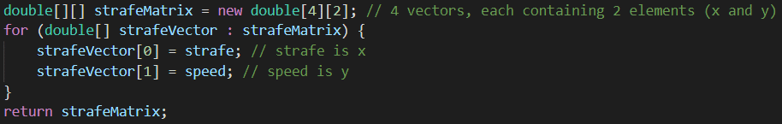

Vectors in Swerve:
Speed and Strafe
Speed (forwards and backwards) and strafe (left and right) can be represented as a vector: $\left\langle strafe,speed\right\rangle$
  strafe is left/right = x, speed is fwd/back = y
All wheels have the same speed/strafe vector
  All wheels point in the same direction and travel the same speed when strafing

Slide 15

Vectors in Swerve:
Turning
When turning in swerve, the wheels lie tangent to a circle
Vectors point clockwise when turning right,
counter-clockwise when turning left
The vector is related to the distance between the front and back wheels, and between the left and right wheels:
  $\overset{⃑}{v}=\left\langle length,width\right\rangle$
  As the bot gets longer, the wheels point farther from forward
  As the bot gets wider, the wheels point closer to forward
Clockwise turn: $\left[\begin{matrix}length & width \\ length & −width \\ −length & −width \\ −length & width\end{matrix}\right]∗1/\sqrt{{length}^{2}+{width}^{2}}$
  Base turning vectors must be unit vectors, scalar is $1/\sqrt{{length}^{2}+{width}^{2}}$

Slide 16
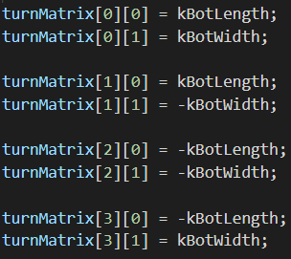
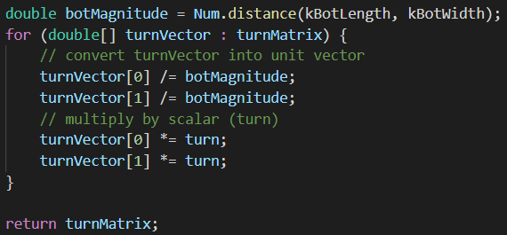
Vectors in Swerve:
Turning
The turning matrix is scaled by the magnitude of the
input turn value
  Since the base turn vectors are unit vectors, this makes each wheel have a turn speed equal to the input turn value
  A negative turn value flips the direction of all vectors, resulting in a counter-clockwise turn

Slide 17
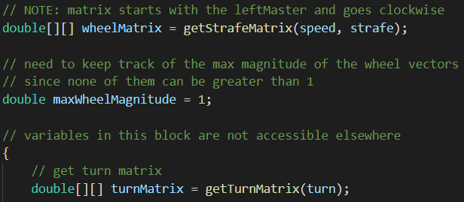
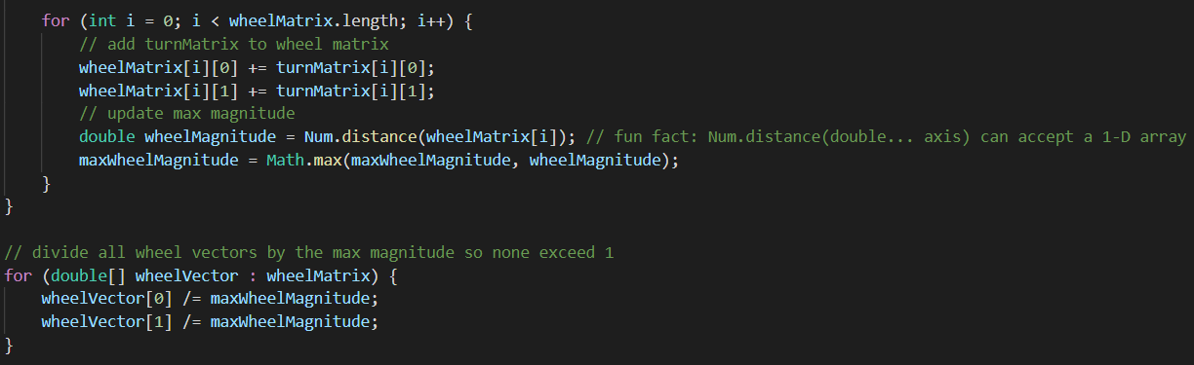
Vectors in Swerve:
Combining the Vectors
The final movement vector for the wheels is the sum of the two vectors (speed and strafe, and turn)
  For the two vectors, larger magnitude = more influence on the final vector
The speed of a wheel cannot be greater than 1.0, so scale down all vectors by the largest magnitude or 1.0, whichever is greater
  If the largest magnitude is less than 1, we don’t want to scale it down; doing so will result in constant max speed

Slide 18
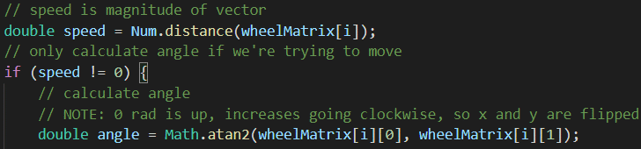


Setting Motor Output
Given a wheel vector $\overset{⃑}{v}=\left\langle x,y\right\rangle$:
  $speed=\left\|\overset{⃑}{v}\right\|$
  $angle=θ=\tan^{−1}\left(\frac{x}{y}\right)$
    Forward is 0 rad, increases turning clockwise, so we flip x and y
Set the percent output of the drive motor to speed
Use Motion Magic to set the turn motor to
Converter.radToEnc(angle, ticksPerRev) (from FRC-217-Libraries)

Slide 19

Setting Motor Output
(Simplified Math)
We can combine all the vectors together and calculate a simple equation for each wheel instead of doing it step by step
Front left example:
$r=Num.distance\left(botLength,botWidth\right)$
$x=strafe+turn\frac{botLength}{r}$
$y=speed+turn\frac{botWidth}{r}$
$double flSpeed=Num.distance\left(x,y\right)$
$double flAngle=\tan^{−1}\left(\frac{x}{y}\right)$

Slide 20
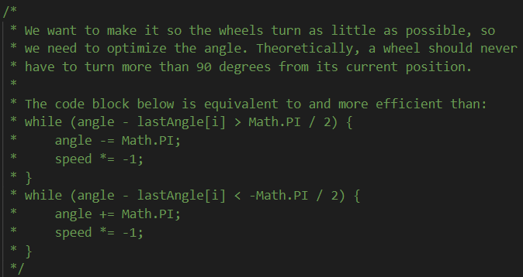
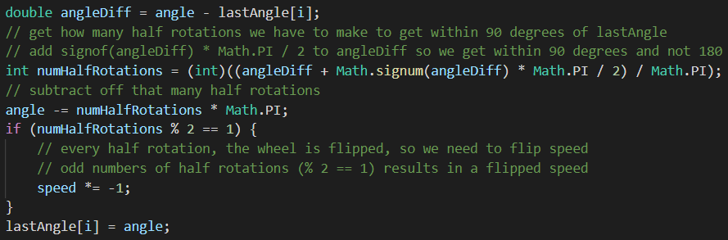

Optimize Swerve Angle
If the last wheel angle was 0 rad, and the new target angle is $\frac{2π}{3}$ rad, we normally turn the wheel $\frac{2π}{3}$ rad
  Inefficient for the turning motor
Instead, flip the drive direction and turn to $−\frac{π}{3}$ rad
  Turns the wheel half the distance

Slide 21

Optimize Swerve Angle –
Explanation of Efficient Algorithm
While the angle diff > $\frac{π}{2}$, subtract $π$ and flip direction of speed
  O(n) (linear) time complexity, takes longer if our wheels are rotated around multiple times
    For absolute encoders that only read one rotation, this is very efficient
    For relative encoders that read to Integer.MAX_VALUE, this is very inefficient
Instead, for relative encoders:
  Calculate how many rotations of $π$ we need
    Any decimal remainder is our angle, so cast to int (truncate)
  Subtract off that many rotations of $π$
  Odd number of rotations = flip direction of speed
    Rotating by $π$ is a semicircle; an even number of $π$ rotations is a full circle

Slide 22

Field Sense
Instead of speed and strafe being relative to the robot, make them relative to the field
  Get angle from gyro/PigeonIMU
  Find difference between angle and the “zero” angle for Field Sense
    The “zero” angle is set when Field Sense toggles from disabled to enabled
  Modify the speed and strafe inputs to form a vector with angle:
    $θ−gyroDiff$ if both $gyroDiff$ and the wheel angle each increase as they turn the same direction
      Ex: as both turn right, both angles increase
      $strafe=strafe\cos\left(gyroDiff\right)−speed sin⁡(gyroDiff)$
      $speed=speed\cos\left(gyroDiff\right)+strafe sin⁡(gyroDiff)$
    $θ+gyroDiff$ if $gyroDiff$ and the wheel angle each increases as they turn opposite directions
      Ex: the wheel angle increases as it turns right, but the gyro increases as it turns left
      $strafe=strafe\cos\left(gyroDiff\right)+speed sin⁡(gyroDiff)$
      $speed=speed\cos\left(gyroDiff\right)−strafe sin⁡(gyroDiff)$

Slide 23

Field Sense – Explanation of math
To rotate a vector, one must perform a linear transformation using the rotation matrix:
$R=\left[\begin{matrix}cos⁡(θ) & −sin⁡(θ) \\ sin⁡(θ) & cos⁡(θ)\end{matrix}\right]$
  When $θ=0$, $R=\left[\begin{matrix}1 & 0 \\ 0 & 1\end{matrix}\right]=\left[\begin{matrix}\hat{i} & \hat{j}\end{matrix}\right]$
  Increasing $θ$ positively rotates vectors counter-clockwise
  $\cos\left(θ\right)=cos⁡(−θ)$, but $\sin\left(θ\right)=−sin⁡(−θ)$, so adding vs subtracting $gyroDiff$ only flips the sign of $\sin\left(θ\right)$
  When we subtract $gyroDiff$, we want to turn counter-clockwise as $gyroDiff$ increases, which is equivalent to increasing $θ$ positively, so $θ=gyroDiff$
  Matrix algebra:
  $\left[\begin{matrix}cos⁡(θ) & −sin⁡(θ) \\ sin⁡(θ) & cos⁡(θ)\end{matrix}\right]\left[\begin{matrix}x \\ y\end{matrix}\right]=x\left[\begin{matrix}cos⁡(θ) \\ sin⁡(θ)\end{matrix}\right]+y\left[\begin{matrix}−sin⁡(θ) \\ cos(θ)\end{matrix}\right]=\left[\begin{matrix}x\cos\left(θ\right)−y sin⁡(θ) \\ y\cos\left(θ\right)+x sin⁡(θ)\end{matrix}\right]$

